Slide 1
Class 7
串列操作應用實例

Slide 2
📌串列操作應用
📌資料加解密原理練習—
簡易轉換法和查表法
📌資料加解密練習—換位法

Slide 3
串列操作應用
使用in找出串列中的資料項
lst = [1, 4, 7, 10, 23, 45, 67, 88]
target = int(input("請輸入你要找的數："))
if target in lst:
print("你的要找的數字{}在數列中！".format(target))
else:
print("你的要找的數字{}並不在數列中！".format(target))

Slide 4
使用inDEX找出串列中資料項的索引值
lst = [1, 4, 7, 10, 23, 45, 67, 88]
target = int(input("請輸入你要找的數："))
if target in lst:
print("你的要找的數字{}在數列中！".format(target))
print("數字{}是在數列中的第{}個位置上。".format(target, lst.index(target)))
else:
print("你的要找的數字{}並不在數列中！".format(target))

Slide 5
如果不使用index的話…
lst = [1, 4, 7, 10, 23, 45, 67, 88]
target = int(input("請輸入你要找的數："))
found = False
for i, number in enumerate(lst):
if number == target:
print("你要找的數字{}在數列中！".format(i))
print("數字{}是在數列的第{}個位置上。".format(target, i))
found = True
break
if not found:
print("你的要找的數字{}並不在數列中！".format(target))

Slide 6
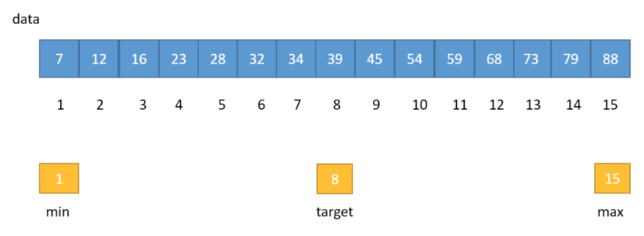

二分搜尋法範例
📄$target= floor\left(\frac{min+max}{2}\right)$

Slide 7
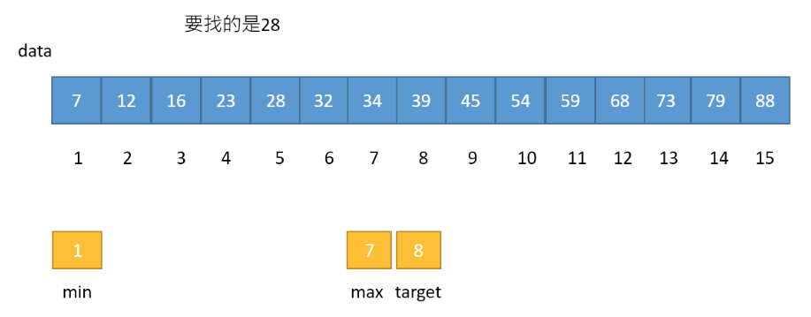
二分搜尋法範例

Slide 8
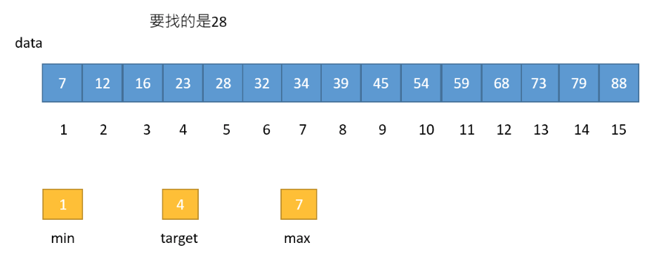
二分搜尋法範例

Slide 9
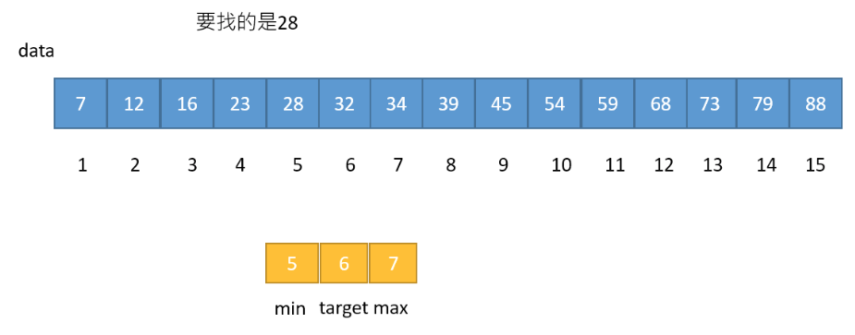
二分搜尋法範例

Slide 10
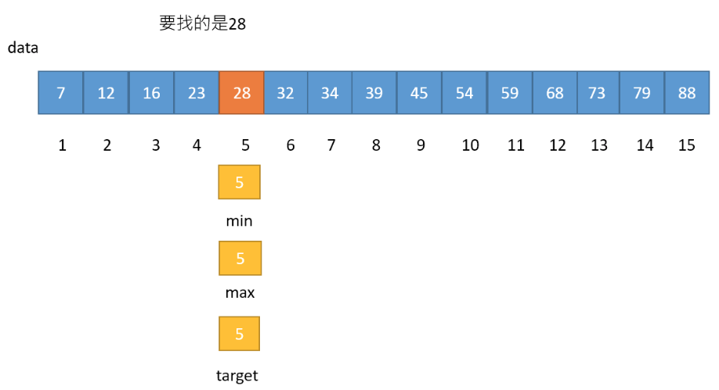
二分搜尋法範例

Slide 11
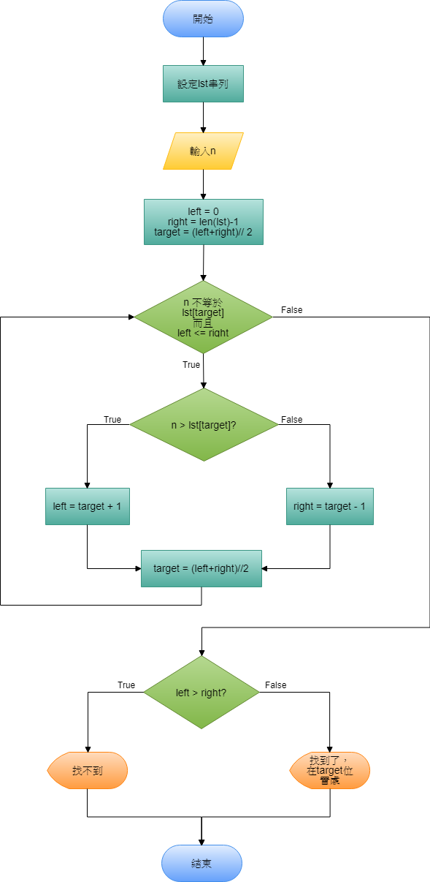
lst = [7, 12, 16, 23, 28, 32, 34, 39, 45, 54, 59, 68, 73, 79, 88]
n = int(input("請輸入你要找的數："))
left, right = 0, len(lst)-1
target = (left + right) // 2
while lst[target] != n and left <= right:
if n > lst[target]:
left = target + 1
else:
right = target - 1
target = (left + right) // 2
print("(n:{},lst[target]:{}), left:{}, right:{}, target:{}".format(
n, lst[target], left, right, target))
if left > right:
print("你的要找的數字{}並不在數列中！".format(n))
else:
print("你要找的數字{}在數列中！".format(n))
print("數字{}是在數列的第{}個位置上。".format(n, target))

Slide 12
執行過程（找到資料）
請輸入你要找的數：59
(n:59,lst[target]:68), left:8, right:14, target:11
(n:59,lst[target]:54), left:8, right:10, target:9
(n:59,lst[target]:59), left:10, right:10, target:10
你要找的數字59在數列中！
數字59是在數列的第10個位置上。

Slide 13
執行過程（找不到資料）
請輸入你要找的數：100
(n:100,lst[target]:68), left:8, right:14, target:11
(n:100,lst[target]:79), left:12, right:14, target:13
(n:100,lst[target]:88), left:14, right:14, target:14
(n:100,lst[target]:88), left:15, right:14, target:14
你的要找的數字100並不在數列中！

Slide 14
找出最大值及其位置
import random
lst = [random.randint(1, 100) for n in range(10)]
max_number = max(lst)
max_number_index = lst.index(max_number)
print(lst)
print("最大值是{}，它的位置在{}。".format(max_number, max_number_index))

Slide 15
找出串列中最大值的演算流程
1️⃣設定lst的內容。
2️⃣max_number_index = 0, max_number = lst[0]
3️⃣i = 1
4️⃣n=lst[i]
5️⃣如果 n > max_number，則 max_number = n, max_number_index = i
6️⃣如果還有還未比對的資料項目，則把i+1，回到4️⃣
7️⃣列出max_number以及max_number_index

Slide 16
手動找出最大值的python程式碼
import random
lst = [random.randint(1, 100) for n in range(10)]
max_number_index = 0
max_number = lst[0]
for i, n in enumerate(lst[1:]):
if n > max_number:
max_number = n
max_number_index = i + 1
print(lst)
print("最大值是{}，它的位置在{}。".format(max_number, max_number_index))

Slide 17
使用zip合併兩個串列資料
b = list('子丑寅卯辰巳午未申酉戌亥')
c = list('鼠牛虎兔龍蛇馬羊猴雞狗豬')
print(zip(b,c))
for item in zip(b, c):
print(item)
print([item for item in zip(b, c)])

Slide 18
執行結果
<zip object at 0x000000C509224E08>
('子', '鼠')
('丑', '牛')
('寅', '虎')
('卯', '兔')
('辰', '龍')
('巳', '蛇')
('午', '馬')
('未', '羊')
('申', '猴')
('酉', '雞')
('戌', '狗')
('亥', '豬')
[('子', '鼠'), ('丑', '牛'), ('寅', '虎'), ('卯', '兔'), ('辰', '龍'), ('巳', '蛇'), ('午', '馬'), ('未', '羊'), ('申', '猴'), ('酉', '雞'), ('戌', '狗'), ('亥', '豬')]

Slide 19
使用巢狀迴圈合併兩個串列資料
('甲', '子')
('甲', '丑')
('甲', '寅')
('甲', '卯')
('甲', '辰')
('甲', '巳')
('甲', '午')
('甲', '未')
('甲', '申')
('甲', '酉')
('甲', '戌')
('甲', '亥')
('乙', '子')
('乙', '丑')
('乙', '寅')
('乙', '卯')
<<略>>
('癸', '亥')
a = list('甲乙丙丁戊己庚辛壬癸')
b = list('子丑寅卯辰巳午未申酉戌亥')
for i in a:
for j in b:
print((i, j))

Slide 20
手工產生天干地支的程式碼
a = list('甲乙丙丁戊己庚辛壬癸')
b = list('子丑寅卯辰巳午未申酉戌亥')
years = list()
a_index = 0
b_index = 0
for i in range(60):
years.append((a[a_index], b[b_index]))
a_index += 1
if a_index >= 10:
a_index = 0
b_index += 1
if b_index >= 12:
b_index = 0
print(years)
[('甲', '子'), ('乙', '丑'), ('丙', '寅'), ('丁', '卯'), ('戊', '辰'), ('己', '巳'), ('庚', '午'), ('辛', '未'), ('壬', '申'), ('癸', '酉'), ('甲', '戌'), ('乙', '亥'), ('丙', '子'), ('丁', '丑'), ('戊', '寅'), ('己', '卯'), ('庚', '辰'), ('辛', '巳'), ('壬', '午'), ('癸', '未'), ('甲', '申'), ('乙', '酉'), ('丙', '戌'), ('丁', '亥'), ('戊', '子'), ('己', '丑'), ('庚', '寅'), ('辛', '卯'), ('壬', '辰'), ('癸', '巳'), ('甲', '午'), ('乙', '未'), ('丙', '申'), ('丁', '酉'), ('戊', '戌'), ('己', '亥'), ('庚', '子'), ('辛', '丑'), ('壬', '寅'), ('癸', '卯'), ('甲', '辰'), ('乙', '巳'), ('丙', '午'), ('丁', '未'), ('戊', '申'), ('己', '酉'), ('庚', '戌'), ('辛', '亥'), ('壬', '子'), ('癸', '丑'), ('甲', '寅'), ('乙', '卯'), ('丙', '辰'), ('丁', '巳'), ('戊', '午'), ('己', '未'), ('庚', '申'), ('辛', '酉'), ('壬', '戌'), ('癸', '亥')]

Slide 21
使用zip產生天干地支（六十甲子）
a = list('甲乙丙丁戊己庚辛壬癸'*6)
b = list('子丑寅卯辰巳午未申酉戌亥'*5)
years = list(zip(a, b))
print(years)

Slide 22
簡易轉換加密法
資料加解密原理練習
clear_text = "the real name of 007 is james bond and he will take action at 1100pm tonight"
print("明文：", clear_text)
print("密文：", end="")
for c in clear_text:
print(chr(ord(c)+2), end="")
明文:the real name of 007 is james bond and he will take action at 1100pm tonight
密文:vjg"tgcn"pcog"qh"229"ku"lcogu"dqpf"cpf"jg"yknn"vcmg"cevkqp"cv"3322ro"vqpkijv

Slide 23
簡易轉換加解密程式
clear_text = "the real name of 007 is james bond and he will take action at 1100pm tonight"
print("明文：", clear_text)
cipher_text = ""
for c in clear_text:
cipher_text += chr(ord(c)+2)
print("密文：", cipher_text)
clear_text = ""
for c in cipher_text:
clear_text += chr(ord(c)-2)
print("解密後：", clear_text)
明文： the real name of 007 is james bond and he will take action at 1100pm tonight
密文： vjg"tgcn"pcog"qh"229"ku"lcogu"dqpf"cpf"jg"yknn"vcmg"cevkqp"cv"3322ro"vqpkijv
解密後： the real name of 007 is james bond and he will take action at 1100pm tonight

Slide 24
查表法加解密程式
row1 = list("abcdefghijklmnopqrstuvwxyz 0123456789")
row2 = list("e5xibuj0chmpys89zd3r vn4wg2qal67tfko1")
encode = dict(zip(row1, row2))
decode = dict(zip(row2, row1))
clear_text = "the real name of 007 is james bond and he will take action at 1100pm tonight"
cipher_text = ""
for c in clear_text:
cipher_text += encode[c]
print(cipher_text)
for c in cipher_text:
print(decode[c], end="")
r0b2dbep2seyb28u2qqk2c32heyb3258si2esi20b2ncpp2remb2exrc8s2er2aaqq9y2r8scj0r
the real name of 007 is james bond and he will take action at 1100pm tonight

Slide 25
ENCODE字典內容
{'a': 'e', 'b': '5', 'c': 'x', 'd': 'i', 'e': 'b', 'f': 'u', 'g': 'j', 'h': '0', 'i': 'c', 'j': 'h', 'k': 'm', 'l': 'p', 'm': 'y', 'n': 's', 'o': '8', 'p': '9', 'q': 'z', 'r': 'd', 's': '3', 't': 'r', 'u': ' ', 'v': 'v', 'w': 'n', 'x': '4', 'y': 'w', 'z': 'g', ' ': '2', '0': 'q', '1': 'a', '2': 'l', '3': '6', '4': '7', '5': 't', '6': 'f', '7': 'k', '8': 'o', '9': '1'}

Slide 26
DECODE字典內容
{'e': 'a', '5': 'b', 'x': 'c', 'i': 'd', 'b': 'e', 'u': 'f', 'j': 'g', '0': 'h', 'c': 'i', 'h': 'j', 'm': 'k', 'p': 'l', 'y': 'm', 's': 'n', '8': 'o', '9': 'p', 'z': 'q', 'd': 'r', '3': 's', 'r': 't', ' ': 'u', 'v': 'v', 'n': 'w', '4': 'x', 'w': 'y', 'g': 'z', '2': ' ', 'q': '0', 'a': '1', 'l': '2', '6': '3', '7': '4', 't': '5', 'f': '6', 'k': '7', 'o': '8', '1': '9'}

Slide 27
換位法對照字串示意產生程式
clear_text = "the real name of 007 is james bond and he will take action at 1100pm tonight"
index = [str(i%4+1) for i in range(len(clear_text))]
str1 = "".join(index)
print(clear_text)
print(str1)TWVSJOEY
the real name of 007 is james bond and he will take action at 1100pm tonight
1234123412341234123412341234123412341234123412341234123412341234123412341234

Slide 28
換位法加密程式
clear_text = "the real name of 007 is james bond and he will take action at 1100pm tonight"
#clear_text = "0123456789abcdef"
cipher_key = [2, 0, 1, 3]
print("錀匙：", cipher_key)
print("明文")
print(clear_text)
#encode process
seg_str = list()
for i in range(0, len(clear_text), 4):
seg_str.append(clear_text[i:i+4])
print(i, end="")
print()
print("切割區塊之後的串列：")
print(seg_str)
cipher_list = list()
for i in cipher_key:
for w in seg_str:
cipher_list.append(w[i])
cipher_text = "".join(cipher_list)
print("密文：")
print(cipher_text)
錀匙： [2, 0, 1, 3]
明文
the real name of 007 is james bond and he will take action at 1100pm tonight
04812162024283236404448525660646872
切割區塊之後的串列：
['the ', 'real', ' nam', 'e of', ' 007', ' is ', 'jame', 's bo', 'nd a', 'nd h', 'e wi', 'll t', 'ake ', 'acti', 'on a', 't 11', '00pm', ' ton', 'ight']
密文：
eaao0smb w et 1pohtr e jsnnelaaot0 ihen 0ia dd lkcn 0tg lmf7 eoahit ia1mnt

Slide 29
換位法加解密程式
clear_text = "the real name of 007 is james bond and he will take action at 1100pm tonight"
#clear_text = "0123456789abcdef"
cipher_key = [2, 0, 1, 3]
print("錀匙：", cipher_key)
print("明文")
print(clear_text)
#encode process
seg_str = list()
for i in range(0, len(clear_text), 4):
seg_str.append(clear_text[i:i+4])
print(i, end="")
print()
print("切割區塊之後的串列：")
print(seg_str)
cipher_list = list()
for i in cipher_key:
for w in seg_str:
cipher_list.append(w[i])
cipher_text = "".join(cipher_list)
print("密文：")
print(cipher_text)
#decode process
result = dict()
index = 0
for k in cipher_key:
for count in range(len(clear_text)//4):
result[count*4+k] = cipher_text[index]
index = index + 1
decoded_list = [result[k] for k in sorted(result)]
decoded_str = "".join(decoded_list)
print("解碼後的字串：")
print(decoded_str)
錀匙： [2, 0, 1, 3]
明文
the real name of 007 is james bond and he will take action at 1100pm tonight
04812162024283236404448525660646872
切割區塊之後的串列：
['the ', 'real', ' nam', 'e of', ' 007', ' is ', 'jame', 's bo', 'nd a', 'nd h', 'e wi', 'll t', 'ake ', 'acti', 'on a', 't 11', '00pm', ' ton', 'ight']
密文：
eaao0smb w et 1pohtr e jsnnelaaot0 ihen 0ia dd lkcn 0tg lmf7 eoahit ia1mnt
解碼後的字串：
the real name of 007 is james bond and he will take action at 1100pm tonight

